Slide 1

DESIGN THINKING AND INNOVATION
BUSINESS STARTUPS AND PROTOTYPE TESTING APPROACHES
Dr V. Ramakrishna
Professor, Civil Engineering Department
Lakireddy Bali Reddy College of Engineering (A), Mylavaram

Slide 2
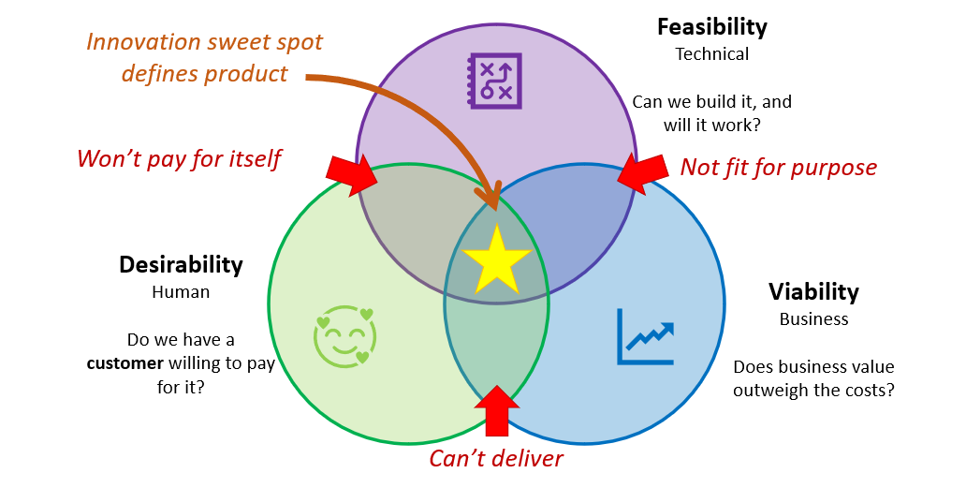
Elements of Design Thinking
Innovation/Outcome

Slide 3
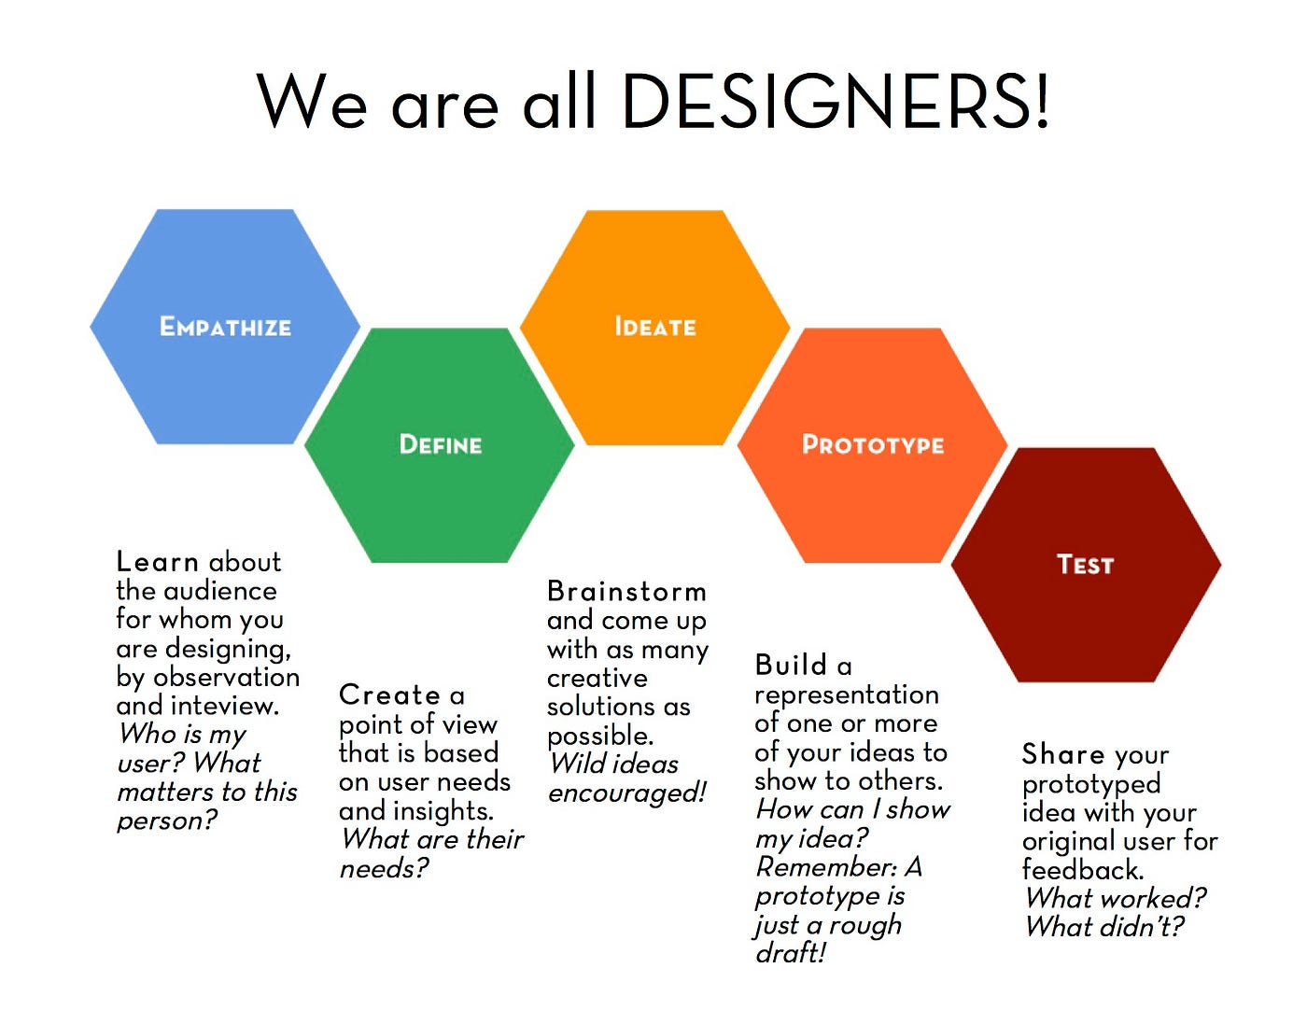
Elements of Design Thinking
INSIGHTS
NEEDS
CONCEPTS
MODELS
REFINE

Slide 4

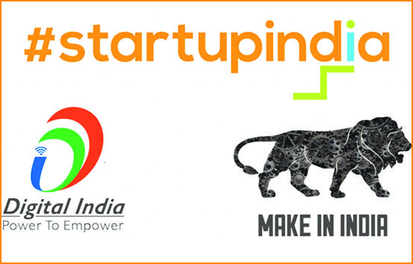
Startup
It is a company in its early stages of operation, typically characterized by high growth potential and a focus on innovation or disruption, often requiring significant investment to get off the ground.
It is a newly created company that relies on information and communication technologies (ICT) to market its products or services. It features a scalable business model in which its priority is to grow quickly and smoothly.
It is a newly formed business with particular momentum behind it based on perceived demand for its product or service.
During the beginning, startups face high uncertainty and have high rates of failure, but a few of them go on to become successful and influential – called as Unicorns

Slide 5
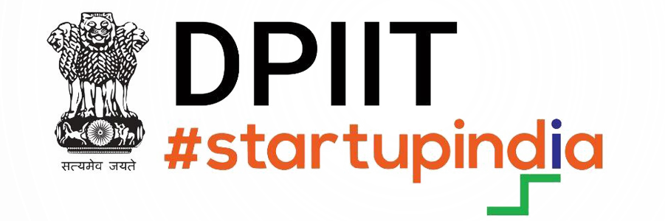
Startup
What is the Startup India Initiative?
Launched on 16th January, 2016, the Startup India Initiative has rolled out several programs with the objective of supporting entrepreneurs, building a robust startup ecosystem and transforming India into a country of job creators instead of job seekers.
These programs are managed by a dedicated Startup India Team, which reports to The Department for Promotion of Industry and Internal Trade (DPIIT)
https://www.startupindia.gov.in/
DPIIT Recognition
Under the Startup India initiative, eligible companies can get recognized as Startups by DPIIT, in order to access a host of tax benefits, easier compliance, IPR fast-tracking and more.

Slide 6
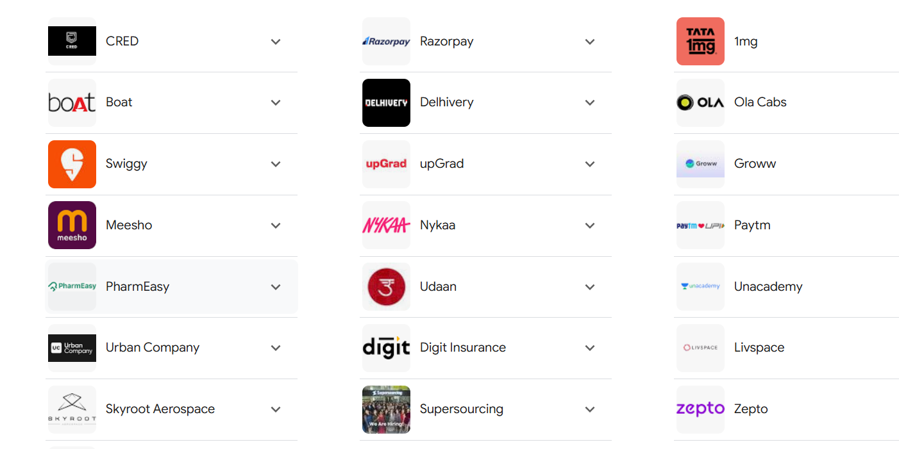
Typical Startups in India

Slide 7
Typical Startups in India
BYJU'S: Edtech giant with a valuation of $16 billion.
Flipkart: E-commerce platform owned by Walmart, with a valuation of $37.6 bn
PhonePe: Digital payments platform, with a valuation of $12 billion.
Swiggy: Food delivery platform, with a valuation of $8 billion.
Dream11: Fantasy sports platform, with a valuation of $8 billion.
Razorpay: Fintech startup, with a valuation of $7.5 billion.
Ola Electric: Electric mobility company, with a valuation of $4 billion.
Paytm: Digital payments and financial services platform, valuation of $16 billion.
Udaan: B2B e-commerce platform, with a valuation of $3.1 billion.
Nykaa: E-commerce platform for beauty and fashion, with a valuation of $8 billion.

Slide 8
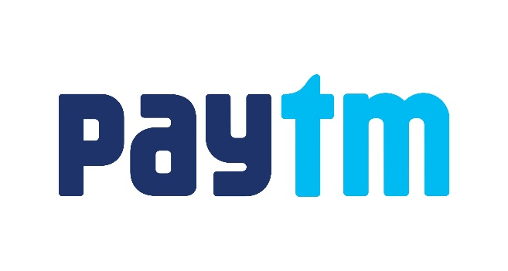
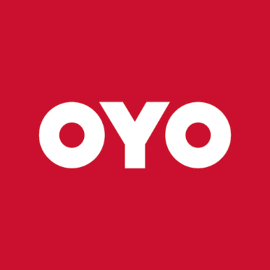
Selected Startup Success Stories
Started: 2013
Founder: Ritesh Agarwal
Industry: Hospitality
Net Valuation: $16 billion
Ritesh Agarwal, the founder of unicorn Startup Oyo, has made Oyo one of the largest hotel chains in the world.
They currently operate in more than 800 urban areas across countries like India, China, Brazil, Japan, United States and 80+ more.
Airbnb was the greatest motivation for Ritesh Agarwal, who began his journey as a traveler and when he found a huge problem in the hotels.
He took it as an opportunity to become an entrepreneur by solving that problem.
Started: 2010
Founder: Vijay Shekhar Sharma
Industry: Fintech
Net Valuation: $15 billion
Paytm began as a digital wallet in its early days and not yet had changed into what it is today.
The fintech administration has had the option to arise as the top fintech organization even in the wake of confronting savage early rivalry from brands like Freecharge.
Paytm's user base developed from 125 million to 185 million three months post demonetization.
Vijay Shekhar Sharma, who was battling to make a decent living with Rs 10 in his pocket, tasted triumph the most difficult way possible, and today, he remains as the author of the billion-dollar local unicorn.

Slide 9
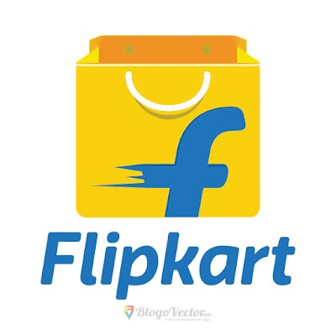

Selected Startup Success Stories
Started: 2007
Originators: Sachin Bansal and
Binny Bansal
Industry: Ecommerce
Assessed Valuation: $24 billion
The Walmart obtained online business organization flipkart remains as the biggest web based business stage in India.
Today, the web based business stage has extended its business skylines by foraying into the video web based industry with Flipkart Video Originals.
Sachin Bansal and Binny Bansal began as an online book shop that made around 20 effective shipments in its first year of working.
It was not late before the stage began catching individuals' eye that made it the top online retail market ever.
Started: 2010
Organizers: Bhavish Aggarwal,
Ankit Bhati
Industry: Mobility
Assessed Valuation: $6.2 billion
Ola Cabs, begun by IIT-B graduates Bhavish and Ankit, has arisen to be the most conspicuous Indian portability specialist organization in the country that offers its administrations across 50 urban areas in India and is equally spread across nations, including the UK, Australia, and New Zealand.
The possibility of Ola, a taxi total startup, came from Bhavish's horrendous experience.
Simultaneously, he was venturing out from Bengaluru to Bandipur, where the driver of his taxi abandoned him in no place over a bombed arrangement bargain. This is a good startup Stories.

Slide 10
Benefits of Design Thinking to Startups
Understanding and Addressing Customer needs
User Research, Empathy mapping and Customer Journey Maps helps in identifying the problems
Validating ideas quickly and Cost-effectively
Ideation sessions, Rapid prototyping and Feedback loops helps in validating effective ideas
Achieving Product Market Fit
Problem framing, User-Centric solutions, and Iterative testing are important in this category
Creating a Differentiated Brand experience
Brand storytelling, Designing for Delight and Touch point optimization are essential in this category
Encouraging a Lean, Agile Culture
Fail first and Learn fast, Cross-functional Collaboration, Responsive Development are important in this category
Enhancing Problem solving Capabilities
Reframing problems, Structured Brainstorming, Data-driven solutions form the core in this category
Scaling, Loyalty and Sustainability
User feedback integration, Flexible scalability, Sustainable practices, Increasing Retention, Value creation are important aspects

Slide 11
Developing Prototypes
Objectives
To create a representation of the product or service that can be tested and iterated upon
To select the type of prototype once the goals of the product or service are outlined
To create the prototype using tools such as Sketch, Figma, Adobe XD or any physical materials
To focus on the key functionalities and design elements
To develop a team with diverse skills and have a collaborative work atmosphere
To gather enough financial resources for a successful output
To create different versions of prototypes based on feedback and refine as per user needs
Steps involved
Define Objectives
Choose type of Prototypes – Low fidelity, Medium fidelity or high Fidelity
Create the prototype
Gather resources
Iterate quickly

Slide 12
Testing Prototypes
Define testing goals
Clearly define what you want to test and what you want to learn from this step
Select testing methods
Usability testing: Involves observing users as they interact with the prototype. This can be done in-person or remotely using techniques such as think-aloud protocols where users articulate their thoughts as they navigate
A/B testing: Compares two versions of a prototype to see which one performs better on specific metrics such as user engagements or conversion rates
Surveys and Questionnaire: Collect quantitative and qualitative feedback from users
Recruit test participants
Identify and recruit individuals who represent the target audience. Their feedback will provide insights into the products usability and appeal

Slide 13
Testing Prototypes
Conduct testing sessions
Facilitate testing sessions in a controlled environment where users can freely interact with the prototype. Encourage open dialogue and ensure participants feel comfortable sharing their thoughts and experiences
Analyze results
Collect and analyze the data from testing sessions, looking for patterns in user behavior, preferences and pain points. Use tools for qualitative and quantitative analysis selectively
Iterate based on feedback
Use the insights gained from testing to refine and improve the prototype. Address any identified issues and make adjustments to features or design elements
Repeat testing
Prototyping is an iterative cycle. Continue testing and refining until the prototype effectively meets user needs and aligns with business objectives

Slide 14
Benefits of Prototyping and Testing
Early detection of the problems
Identification of design flaws or usability issues early reduces costly changes later on
Enhanced User Engagement
Involving users in the testing phase fosters a sense of ownership and can lead to valuable insights that drive design improvements
Refined Product Design
Iterative testing and feedback enable teams to refine the product continually enhancing its appeal and usability
Risk reduction
Validating concepts before full-scale development can minimize the risk of failure
Improved communication
Prototypes serve as visual communication tools that help stakeholders understand the product vision, fostering alignment among team members

Slide 15
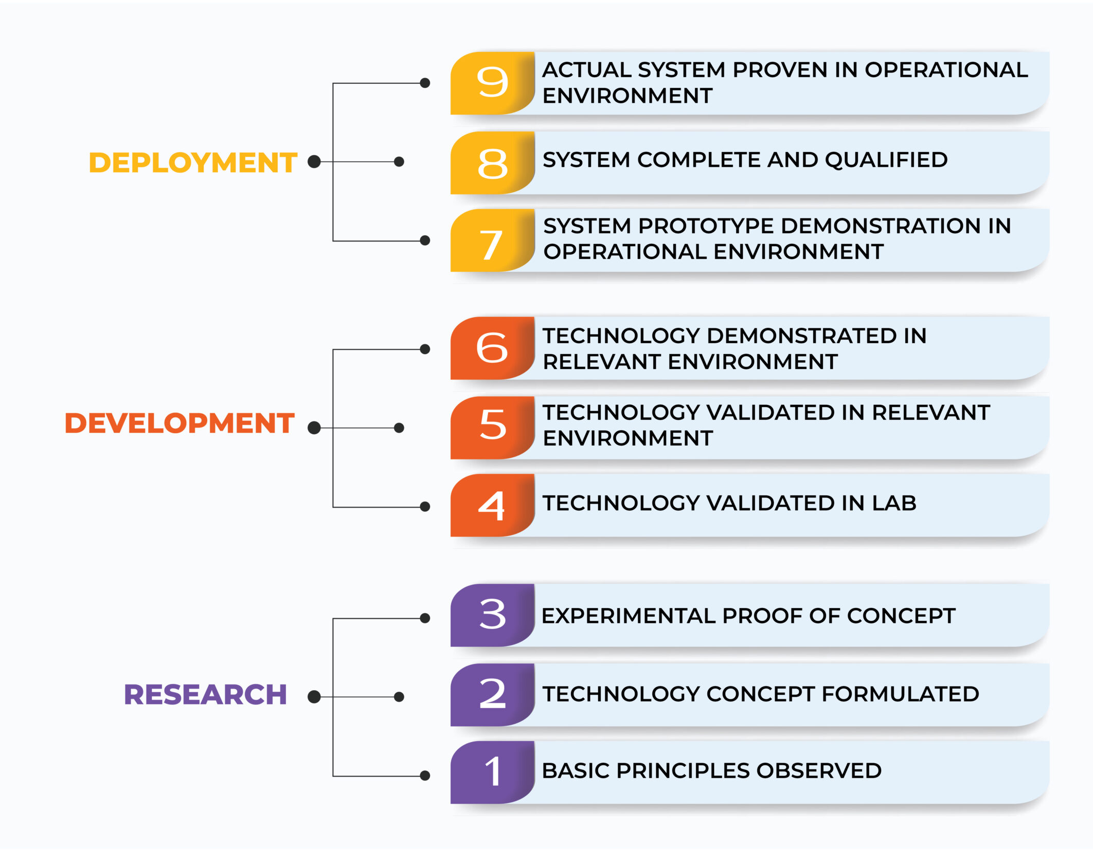
Technology Readiness Levels (TRLs)
The TRL is a system for assessing the maturity of a technology, ranging from basic research (TRL1) to fully operational deployment (TRL9).
The TRL is used to track the progress of technology development and ensure consistent evaluation across different fields.

Slide 16
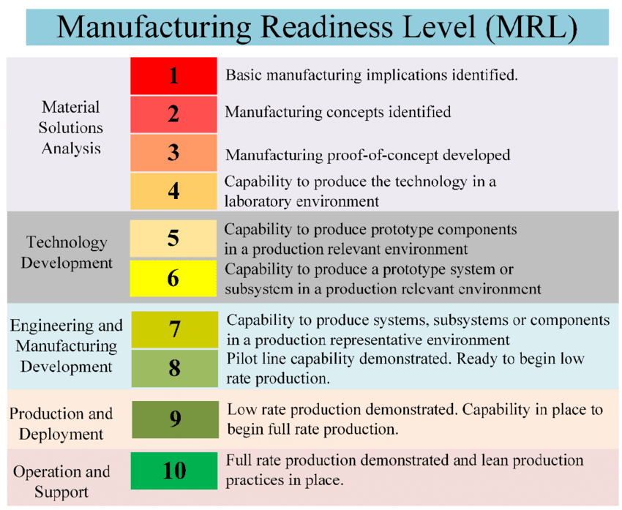
Manufacturing Readiness Levels (MRLs)
The MRL is a measure to assess the maturity of manufacturing readiness, similar to how technology readiness levels are used for technology readiness.
The MRLs can be used in general industry assessments, or for more specific application in assessing capabilities of possible suppliers.

Slide 17
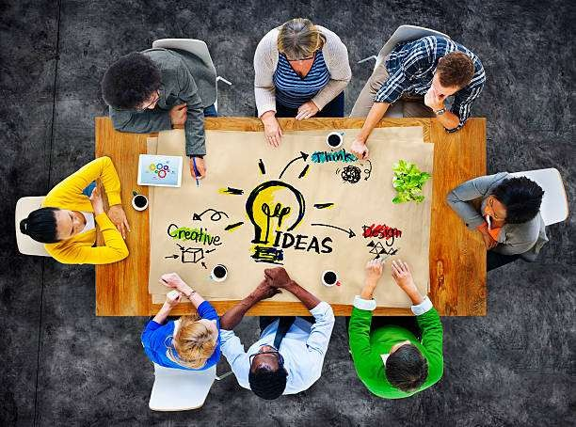

Startups and Prototype testing - Activity
Activity
Students should identify a problem for product/service development
any household accessories eg. TV, AC, Washing machine, smart watch, smart phone etc.,
or automobiles eg. Scooter, Bike, Car etc.
or any other
Plan a startup. Identify how you can apply design thinking for its development. List out all the steps using a flowchart or illustration
Take a case study of successful startups in India or anywhere. List out how they started, travelled and developed to their present stage of operation.

Slide 18


